Slide 1
Calibration and validation of the Ice Floe Tracker algorithm
Cloud mask
Preprocessing
Ice labeling (semantic segmentation)
Floe detection (object-based segmentation)
Tracking
Notes:
Should cross compare Ellen’s histogram method with the IFT method for #3
Idea from Ellen about GUI for manual pixel labeling – see if we can figure out what it’s called

Slide 2
Timeline
Watkins et al. “Observing floe-scale ice motion during summer” AoG
Fram Strait dataset and demonstration of data utility + Poster presentation at AGU
Nov
Revised draft to coauthors + Jenny by Nov. 25, 2024
Re-submit to Annals of Glaciology by Dec. 6, 2024
Watkins et al., “IceFloeTracker.jl: Open Source Software for …” JOSS
Demonstrate scientific need for software, document its capability
Finish draft of documentation pages
Draft 2024 NASA report
Dec
Jan
Feb
Hatcher et al. “Evaluating object-based sea ice segmentation.” IEEE TGRS
Evaluation dataset(?) and metrics. Application of Simon’s methods.
Mar
Watkins et al. Calibration/validation of the cloudmask, preprocessing, segmentation, and tracking (for original IFT)
Description of cal-val methods
Dataset, and potentially scientific result if the venue is appropriate
Apr
May
Jun

Slide 3
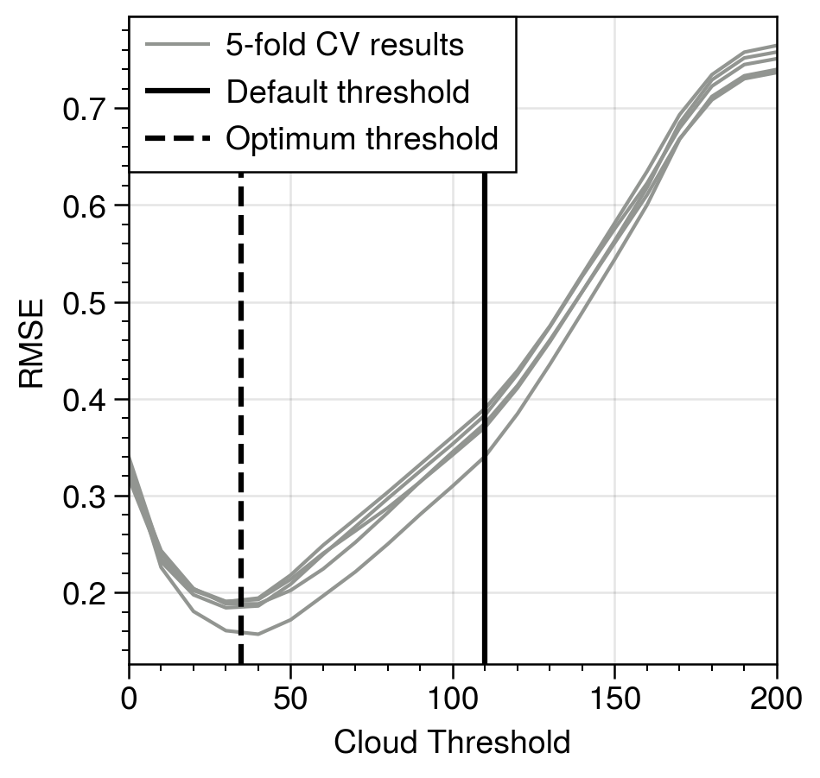
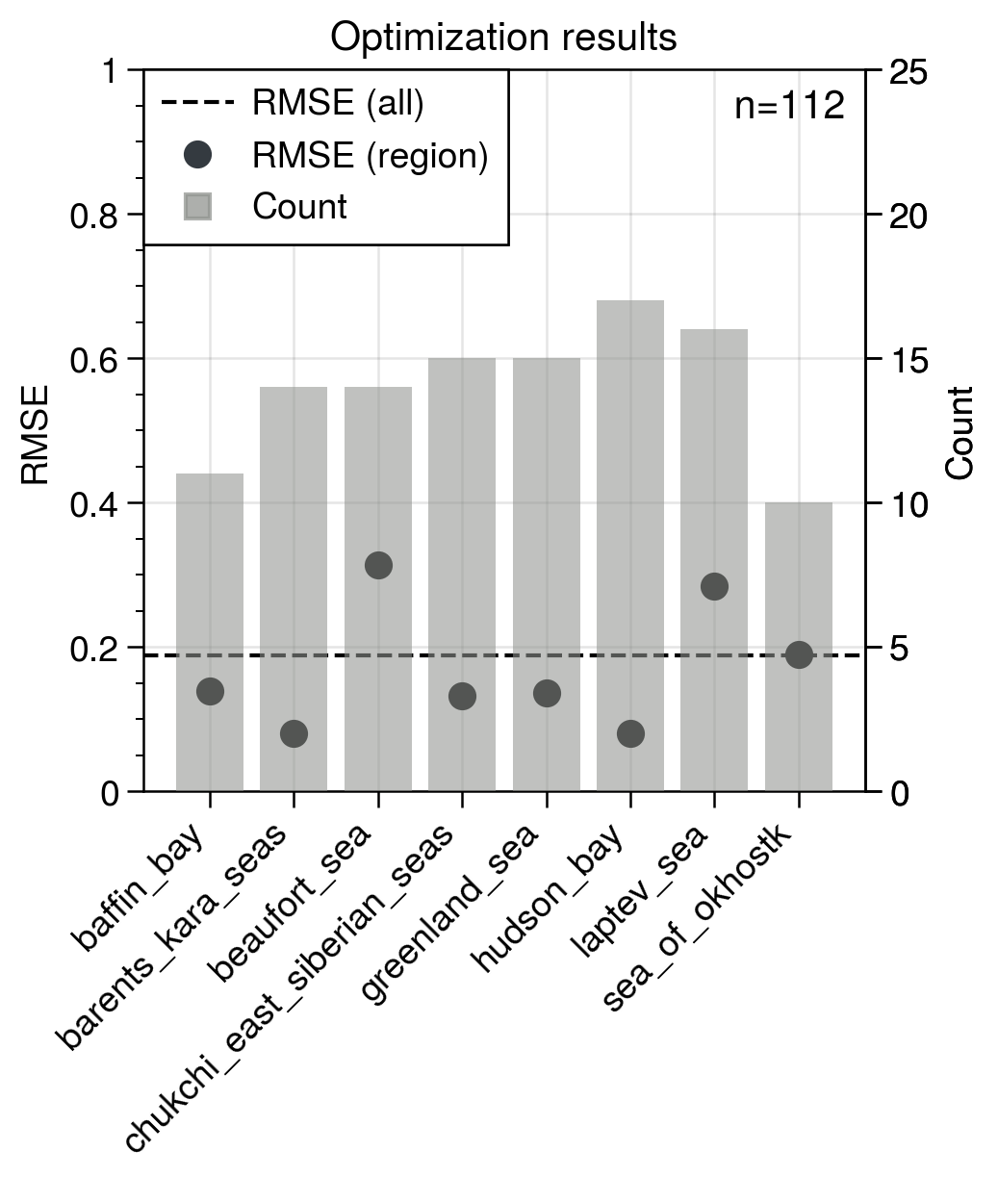
1. Cloud mask
The cloud mask functionality produces a binary image (clouds/not clouds). Fundamentally, however, we are actually creating 3 categories internally: opaque cloud, transparent cloud, and no cloud.
The algorithm does this by (1) applying a threshold to separate cloudy and clear pixels, then (2) using a pair of thresholds and a ratio test to set some of the flagged cloudy pixels as clear.
My approach:
Find the best performing threshold for identifying the total cloud fraction
Find the set of thresholds and ratios to maximize the number of “unmasked” floes while minimizing the total number of unmasked pixels.
Step 1 is conceptually the simplest as there is only one adjustable parameter. Initial results are based on the manually identified cloud fractions from the test dataset. This dataset is subject to human error but provides a baseline starting point for the analysis. The data show that the default threshold of 110 underestimates the total cloud fraction relative to the manual estimate.
For step 2, the optimization is more complex because it occurs across three parameters. There is also less available data: while the first step can use every image, the second step will be sensitive to the number of labeled ice floes.
Methodology: Divide the data into a testing and training set. 2/3 of images are randomly sampled to go into the training dataset. The remaining 112 images are used for testing. The training dataset is further divided at random into 5 groups for cross-validation. Cloud fraction (CF) is defined as the fraction of pixels in an image that are higher than the threshold.
Results: The left figure shows the root mean square error (RMSE) between manually estimated CF and calculated CF. The black line shows the default threshold of 110 and the dashed line is the average minimizing threshold (35) across the CV tests. On the right, we see the count per region and the RMSE for CF estimated using the optimal threshold by region (dots) and across the whole dataset (line).

Slide 4
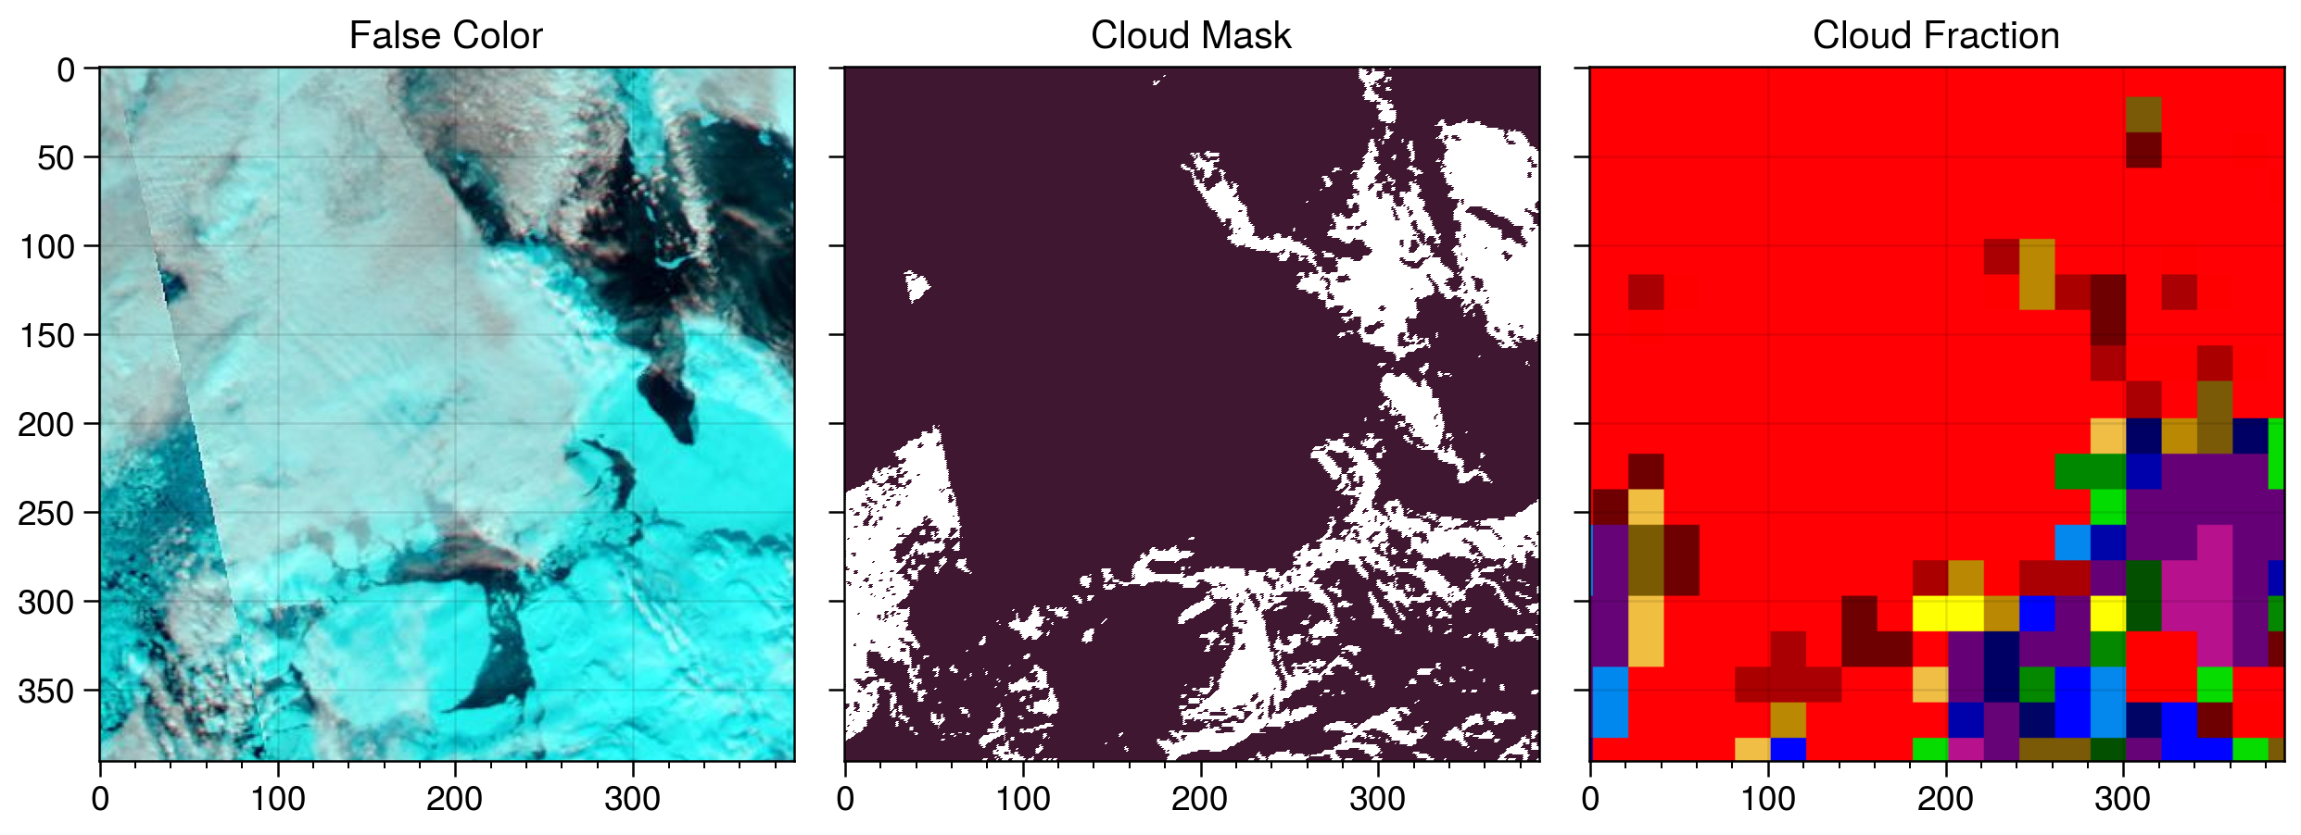
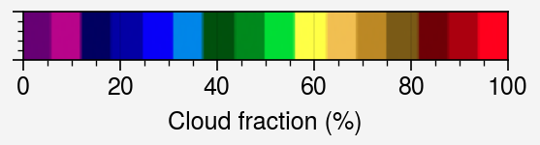
1. Improving the approach
A fundamental weakness of the prior approach is that the total cloud fraction estimate is subject to human error. While the images have been examined by multiple observers, we want to make sure that our optimized function is not biased by human biases.
The MODIS cloud fraction product
There is a validated MODIS cloud product that includes cloud fraction and cloud optical thickness. Unfortunately, for the snapshot mosaic imagery we are using for IFT, it is only available as colorized images (bottom right). This is the data that Ellen used. To get numerical data, we need to use the Level 2 imagery, which will not totally align with the images in our validation dataset. There are also some issues with data quality that affect the polar regions.
Options
Map the colors to fractions to allow direct comparison with the snapshot data. This is doable, though not as precise as I’d like.
Download Level 2 data for the cloud fraction and for the false color data, hoping that the color processing on the false color snapshots is the same as the Level 2 data
Case 021, Baffin Bay (Aqua, 2012-04-22). Left to right: False color image, cloud mask (total, prior to unmasking), and cloud fraction snapshot.

Slide 5
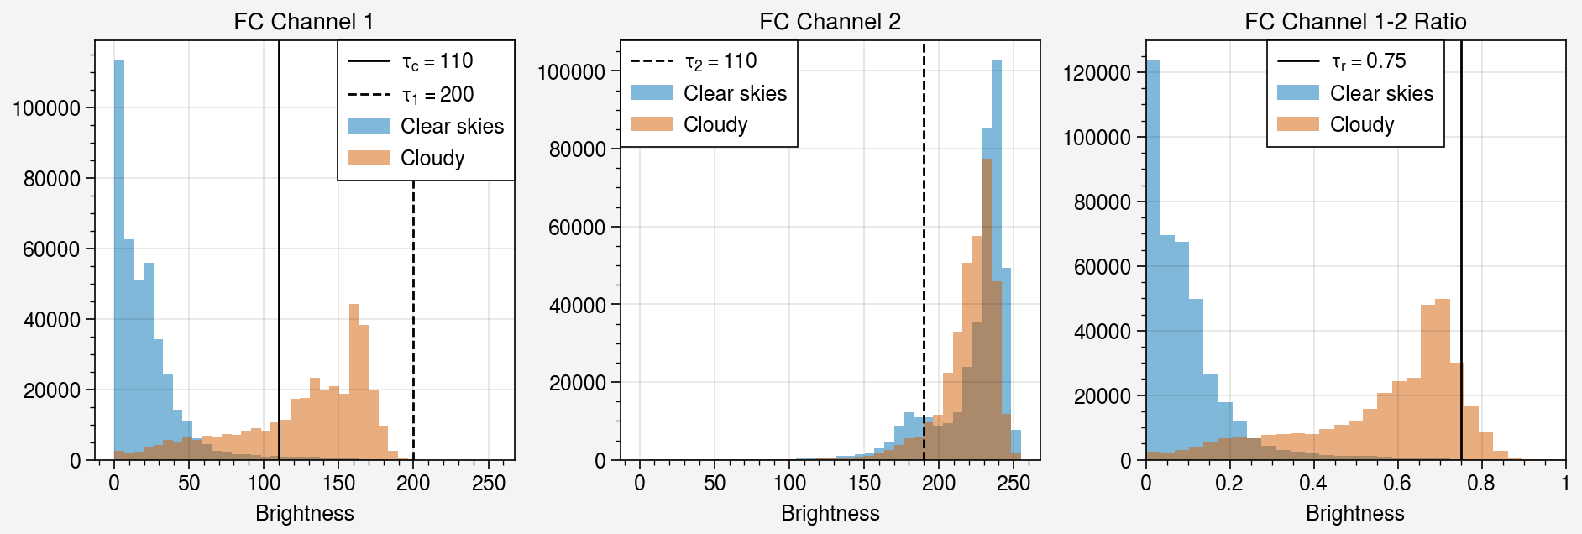
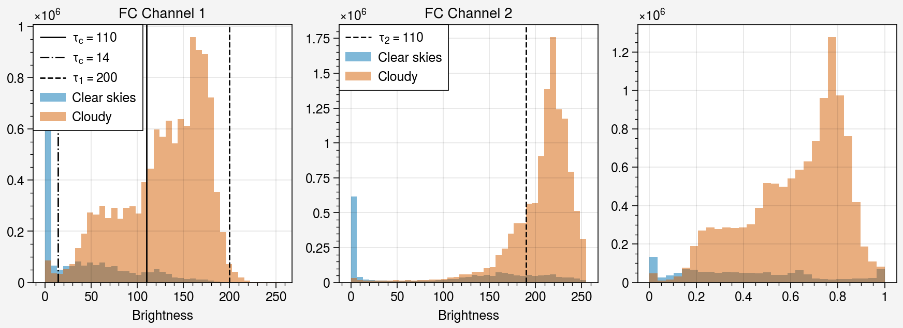
Cases with visible sea ice floes
The histograms on the right show the default thresholds (vertical lines) and the pixel brightness / pixel brightness ratios for labeled sea ice floes under clear skies (blue) and cloudy skies (orange). The algorithm labels pixels with FC Ch 1 > tc as clouds. Cloudy pixels with FC Ch 1 < t1 and FC Ch 2 > t2, or with Ch 1-2 ratio < tr, are unmasked.
The first step shows that much lower tc minimizes error in estimated cloud fraction.
For the second step, we want to find a combination of thresholds for t1, t2, and tr that
minimizes the number of uncovered cloudy pixels
maximizes the number of uncovered sea ice pixels
We can do this by performing a Monte Carlo parameter search
Cases with no visible sea ice

Slide 6
2. Preprocessing
Questions
What objective metric can we use to evaluate the quality of choices here?
Parameters available to optimize
Number of tiles (overall and within the histogram equalization)
Thresholds for the entropy and BW for applying histogram equalization
Size of the structuring elements
Settings for the sharpening algorithm (Gaussian radius, sharpening intensity)
Challenges
Global parameter sweeps are expensive when there are many parameters to test.
Defining a cost function: what can we use use to measure success?
This step will affect the success of the segmentation, however the best performing parameters for the segmentation algorithms are also likely to depend on the quality of the preprocessing routines.
One idea: testing the contrast at object edges (floes, landfast ice) against the contrast within objects. Edge contrast should be maximized while interior contrast should be minimized.

Slide 7
3. Semantic segmentation
Testing the pixel-by-pixel classification:
Water
Dark ice
Light ice
Potential floes
Need to decide on a dataset for testing the segmentation.
Note: right now, we are only ever assigning one class in the k-means results to ice floes. It’s possible that there are multiple colors of ice, for example when there are gray ice floes and multiyear.

Slide 8
4. Object-based segmentation
Uncertainty in feature parameters
Quality of the shape detection
Perimeter, centroid, area – propagating uncertainty due to digital representation
Set of metrics for callibration
Under/over segmentation
Area mismatch
Non-detection

Slide 9
5. Tracking
easy improvement: change “get_time_space_proximity_condition” to be an empirical function of delta t and delta x rather than a series of thresholds.
The success of the tracking algorithm depends on the accuracy of the measurements of area, axes, perimeters, area mismatch, and psi-s correlation. Currently, thresholds are used instead of measures of uncertainty.
ratios, conditions, dist = compute_ratios_conditions()
the ratios are normalized by the mean: abs(x – y)/mean(x, y)
computes ratios of area, major axis, minor axis, and convex area
area_mismatch, corr = matchcorr()
true/false = isfloegoodmatch(conditions, mc_thresholds.goodness, area_mismatch, corr)
(conditions.large_floe_condition && area_mismatch < mct.small_floe_area) || (conditions.small_floe_condition && area_mismatch < mct.large_floe_area)) && corr > mct.corr
getbestmatchdata
remove_collisions

Slide 10
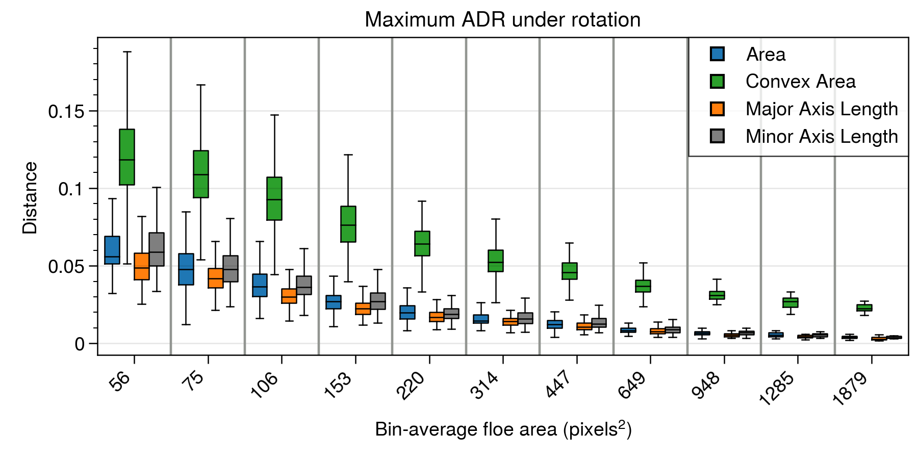
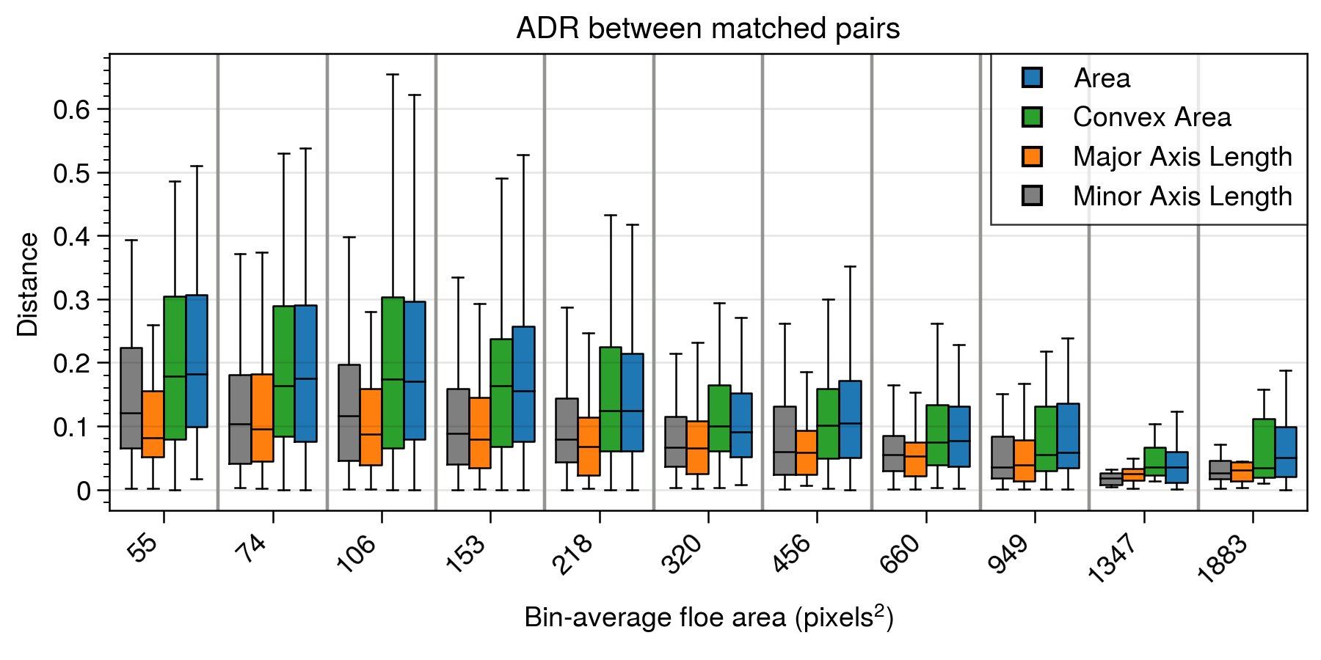
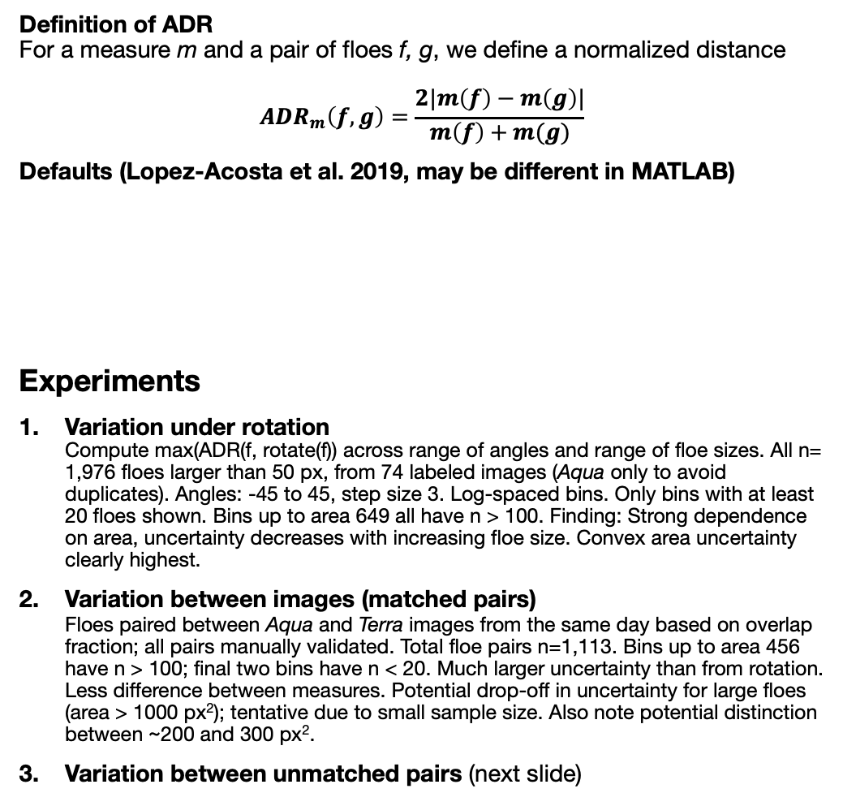
5. Tracking: Estimating best thresholds for the absolute difference ratios
Definition of ADR For a measure m and a pair of floes f, g, we define a normalized distance $$ADR_{m}\left(f, g\right)=\frac{2|m\left(f\right)−m\left(g\right)|}{m\left(f\right)+m(g)}$$
Defaults (Lopez-Acosta et al. 2019, may be different in MATLAB)
Experiments
Variation under rotation Compute max(ADR(f, rotate(f)) across range of angles and range of floe sizes. All n= 1,976 floes larger than 50 px, from 74 labeled images (Aqua only to avoid duplicates). Angles: -45 to 45, step size 3. Log-spaced bins. Only bins with at least 20 floes shown. Bins up to area 649 all have n > 100. Finding: Strong dependence on area, uncertainty decreases with increasing floe size. Convex area uncertainty clearly highest.
Variation between images (matched pairs) Floes paired between Aqua and Terra images from the same day based on overlap fraction; all pairs manually validated. Total floe pairs n=1,113. Bins up to area 456 have n > 100; final two bins have n < 20. Much larger uncertainty than from rotation. Less difference between measures. Potential drop-off in uncertainty for large floes (area > 1000 px²); tentative due to small sample size. Also note potential distinction between ~200 and 300 px².
Variation between unmatched pairs (next slide)
Floe Size | Area | Convex Area | Major Axis Length | Minor Axis Length
Area < 1200 px² | 0.18 | 0.09 | 0.07 | 0.08
Area > 1200 px² | 0.28 | 0.14 | 0.10 | 0.12
Bin boundaries are logarithmically spaced in area and are the same in each plot. Tick marks are labeled with the bin-mean area; hence small differences between top and bottom panels. Box-and-whiskers show the median (center line), 25-75 range (IQR, box width), and whiskers extend from the box to the most extreme data point within 1.5*IQR past the median.
Notes:
Additional tests
The above experiments focus on shape variation with true ice floes. Another function of the ratios could be considered the question of screening false positives. However, that type of screening may be best at a different stage in the algorithm.
Notes
Open experiment design question: how many labeled images should be left out of the parameter fitting, threshold estimation, etc. tests for testing at the end?
Check default settings for box plot. What are the percentiles shown by the whiskers?

Slide 11
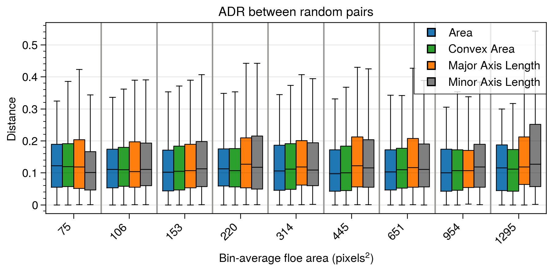
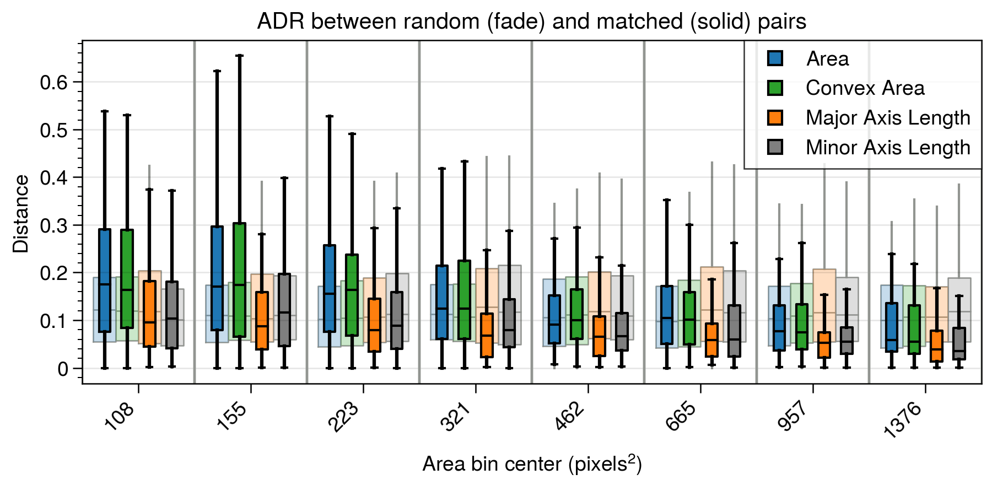
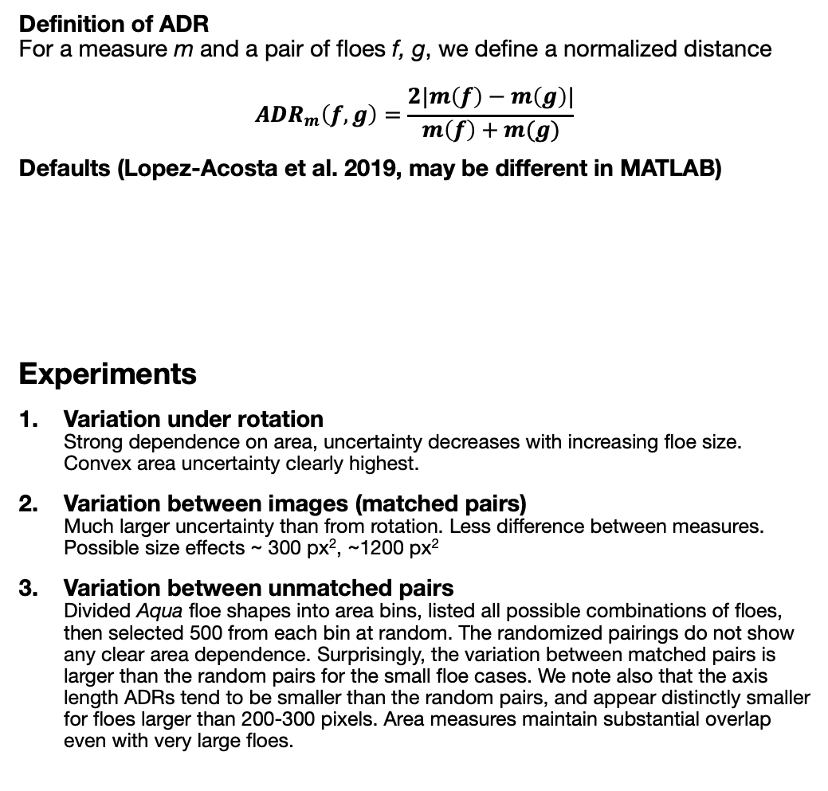
5. Tracking: Estimating best thresholds (cont’d)
Definition of ADR For a measure m and a pair of floes f, g, we define a normalized distance $$ADR_{m}\left(f, g\right)=\frac{2|m\left(f\right)−m\left(g\right)|}{m\left(f\right)+m(g)}$$
Defaults (Lopez-Acosta et al. 2019, may be different in MATLAB)
Experiments
Variation under rotation Strong dependence on area, uncertainty decreases with increasing floe size. Convex area uncertainty clearly highest.
Variation between images (matched pairs) Much larger uncertainty than from rotation. Less difference between measures. Possible size effects ~ 300 px², ~1200 px²
Variation between unmatched pairs Divided Aqua floe shapes into area bins, listed all possible combinations of floes, then selected 500 from each bin at random. The randomized pairings do not show any clear area dependence. Surprisingly, the variation between matched pairs is larger than the random pairs for the small floe cases. We note also that the axis length ADRs tend to be smaller than the random pairs, and appear distinctly smaller for floes larger than 200-300 pixels. Area measures maintain substantial overlap even with very large floes.
Floe Size | Area | Convex Area | Major Axis Length | Minor Axis Length
Area < 1200 px² | 0.18 | 0.09 | 0.07 | 0.08
Area > 1200 px² | 0.28 | 0.14 | 0.10 | 0.12
Notes:
Additional tests
The above experiments focus on shape variation with true ice floes. Another function of the ratios could be considered the question of screening false positives. However, that type of screening may be best at a different stage in the algorithm.
Notes
Open experiment design question: how many labeled images should be left out of the parameter fitting, threshold estimation, etc. tests for testing at the end?
Also, it’s not clear in the paper what the percentages are calculated relative to.

Slide 12
5. Tracking: Estimating best thresholds for psi-s correlation and shape mismatch
Floe Size | SD | Psi-S
Area < 1200 px² | 0.18 | 0.7
Area > 1200 px² | 0.24 | 0.7
Notes:
Note: Units for the SD are not exactly clear in the paper.

Slide 13
Studies/papers that may be useful
On the use of daily optical imagery for sea ice velocity analysis
Timescales of ice motion (hourly, daily, weekly) vs uncertainty. Analysis using meander coefficients from Alan’s work.
Available timescales for linked trajectories based on cloud cover. Potentially using Sami’s work, alternatively, just use the cloud fraction dataset (e.g. could be place to do the eval of the cloud fraction dataset).
Relationship between cloud cover, wind speed, and the observed portion of the velocity distribution.
This paper would help benchmark performance needs. I.e., are we getting as long of trajectories as we can given the cloud cover properties? How should we interpret our velocity distributions vs. the true distributions?
Relative and absolute dispersion of tracked ice floes
Uncertainty analysis for limits of the interpolation step, questions of how to handle the floe position uncertainty in the dispersion calculation
Confidence intervals for the slope of the dispersion
Link between dispersion and deformation strain rates
Compare/contrast sea ice regions, with analysis of Greenland Sea vs Beaufort Sea
“We are preparing two manuscripts focused on the Lagrangian statistics of the sea ice trajectories: the first, “Sea ice dispersion mirrors underlying submesoscale ocean currents amid strong atmospheric forcing”, by Watkins, Lopez-Acosta, Kim, and Wilhelmus, focuses on the absolute dispersion of Fram Strait IFT trajectories and trajectory-based eddy detection and will be submitted to Nature Geoscience.
The second focuses on multi-particle statistics, including relative dispersion and structure function analysis, and includes intercomparison with multiple drifting buoy deployments. This paper has the working title “Lagrangian statistics of in-situ and remote sensing sea ice observations in the Spring- and Summertime Marginal Ice Zones” and will be submitted to The Cryosphere. “
Seasonality of the FSD in Arctic MIZs
Extend analysis from the Annals paper into the whole set of MIZs
Compute sea ice fraction, total ice area for each scene for looking at interannual variability. What fraction of the ice cover consists of identifiable ice floes?
Preconditioning: test hypothesis that the FSD in April or March is a predictor of the FSD slope in the late season

Slide 14
Paper: Evaluation of sea ice segmentation with manually labeled imagery
Using a set of manually identified sea ice floes, we carry out an experiment to test the sensitivity of a set of segmentation quality metrics to errors in object properties and sampling. As an example, we apply the best-performing metrics to a set of segmentation results from two versions of an ice floe segmentation and tracking algorithm.

Slide 15
1. Objectives and overview
Adapt practices from GEOBIA and computer vision to the challenge of evaluating sea ice segmentation quality
Determine measures to use for calibration
Introduce the random sample dataset
Test the measures with two versions of IFT

Slide 16
1. Data: Random sample dataset
Random sampling procedure. Aim is to select random (x, y, t) triads (position and time) from the marginal ice zone (MIZ).
MIZ defined by SIC between 15 and 85%
Further requirement that the 100 km by 100 km square centered at (x, y) have SIF (area of pixels with > 15% SIC) larger than 0.25.

Slide 17
1. Data: Synthetic dataset
Adding known errors so that we can test the sensitivity of metrics.
Sampling bias: increasing fraction of false negatives. Randomly select floes to delete. Also test sensitivity to deleting small floes vs large floes.
Sampling bias: increasing fraction of false positives. Randomly add circles of similar sizes to blank areas of images. Test sensitivity with small vs large floes.
Area bias: dilate floes by n pixels (n from 1 to 10 or so), erode floes by n pixels.
Boundary errors: will need a way to do this. Perhaps replacing floes with shape with similar size, but not overlapping with other floes? Area change also affects the boundary.
Oversegmentation and undersegmentation. For undersegmentation, I can join objects, either through dilation or through

Slide 18
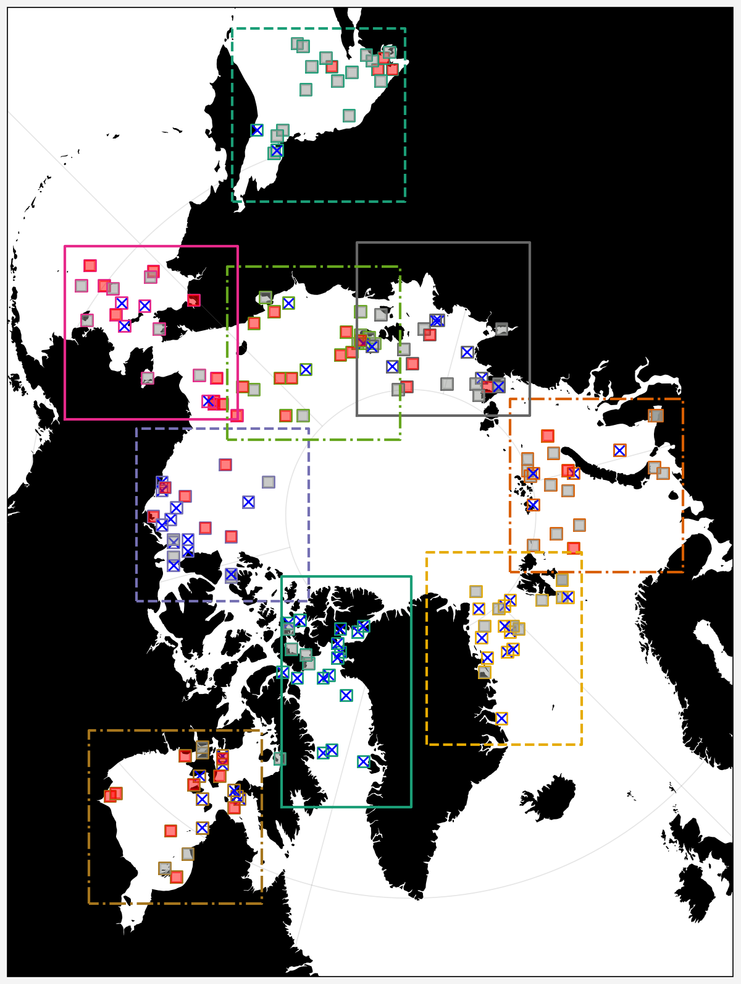
Bering-Chukchi Seas – some edge cases, could move box slightly to the right and down, so that the right boundary goes through Wrangel Island and the lower boundary through Point Barrow.
Beaufort Sea – shrink the box so that the eastern border is at the island, northern border doesn’t really matter much.
Canadian Archipelago - new tile, include the Beaufort Sea images that were already analyzed.
Hudson Bay – extend slightly to the south and east
Baffin Bay – narrower, extend further south.
Greenland Sea – Svalbard to the North, iceland to the south, Jan Mayen to the east,
Barents-Kara Seas – share border with Laptev and Greenland sae
Laptev Sea – make smaller, reassign samples to the East Siberian sea. Make “north” edge the same.
East Siberian Sea – wrangel island to the west, new siberian islands to the right
Sea of Okhostk – very few images with visible floes. Should sampling continue until n images with visible floes are identified? Does it matter?

Slide 19
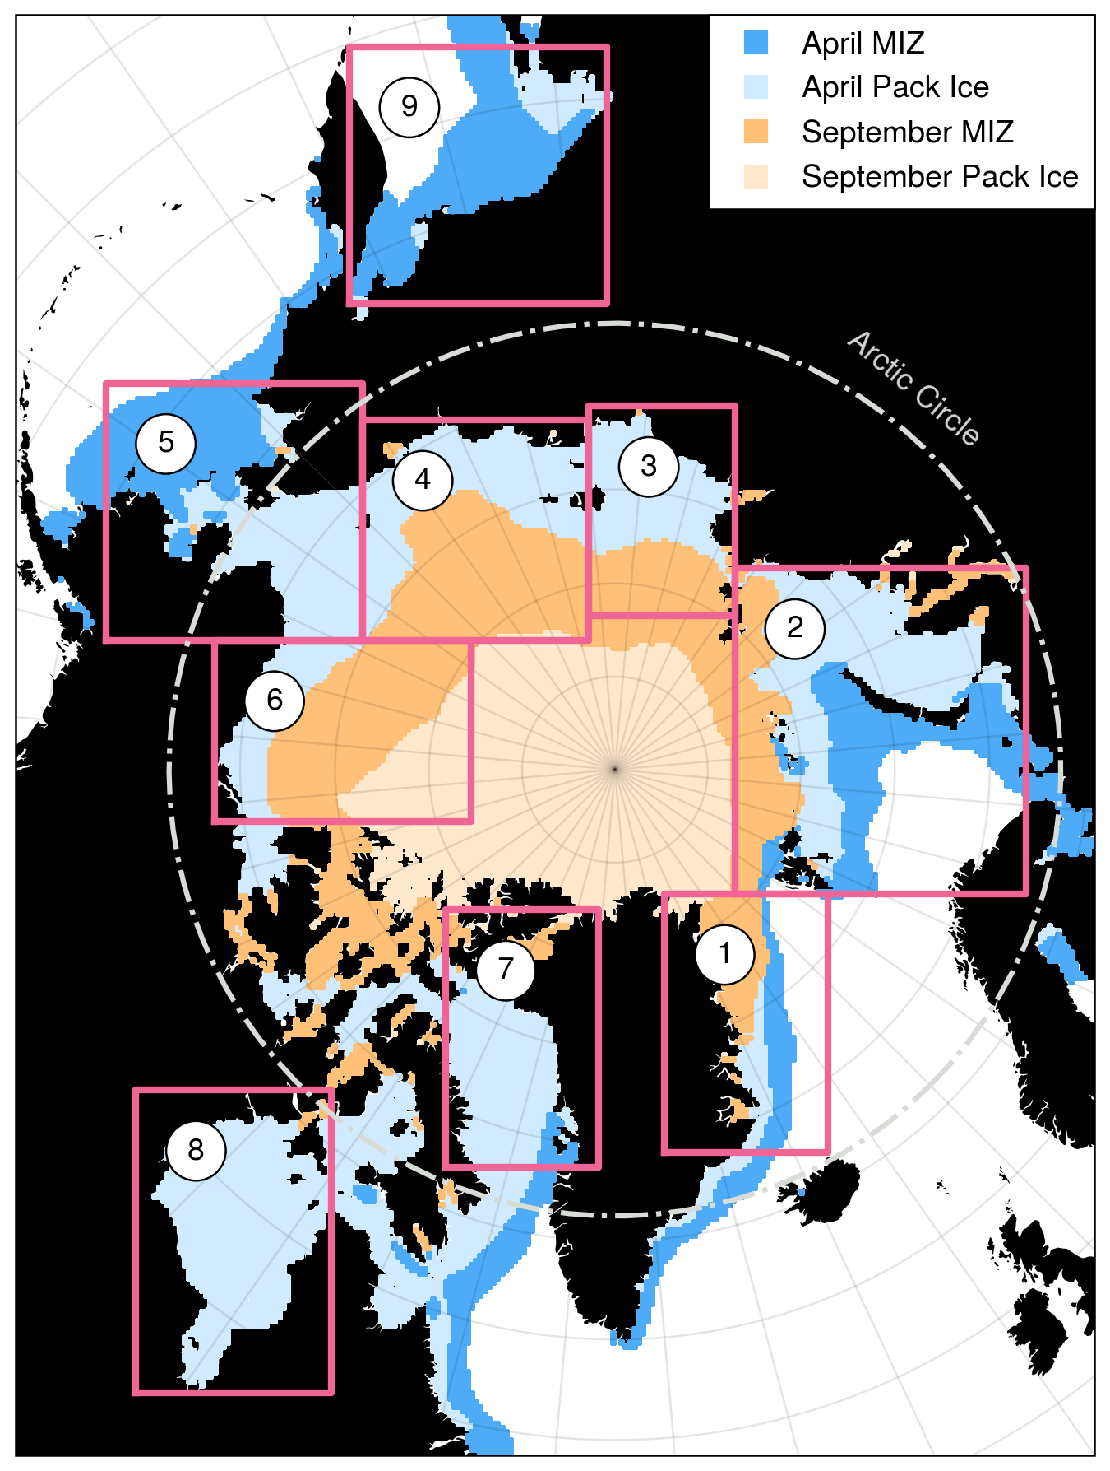
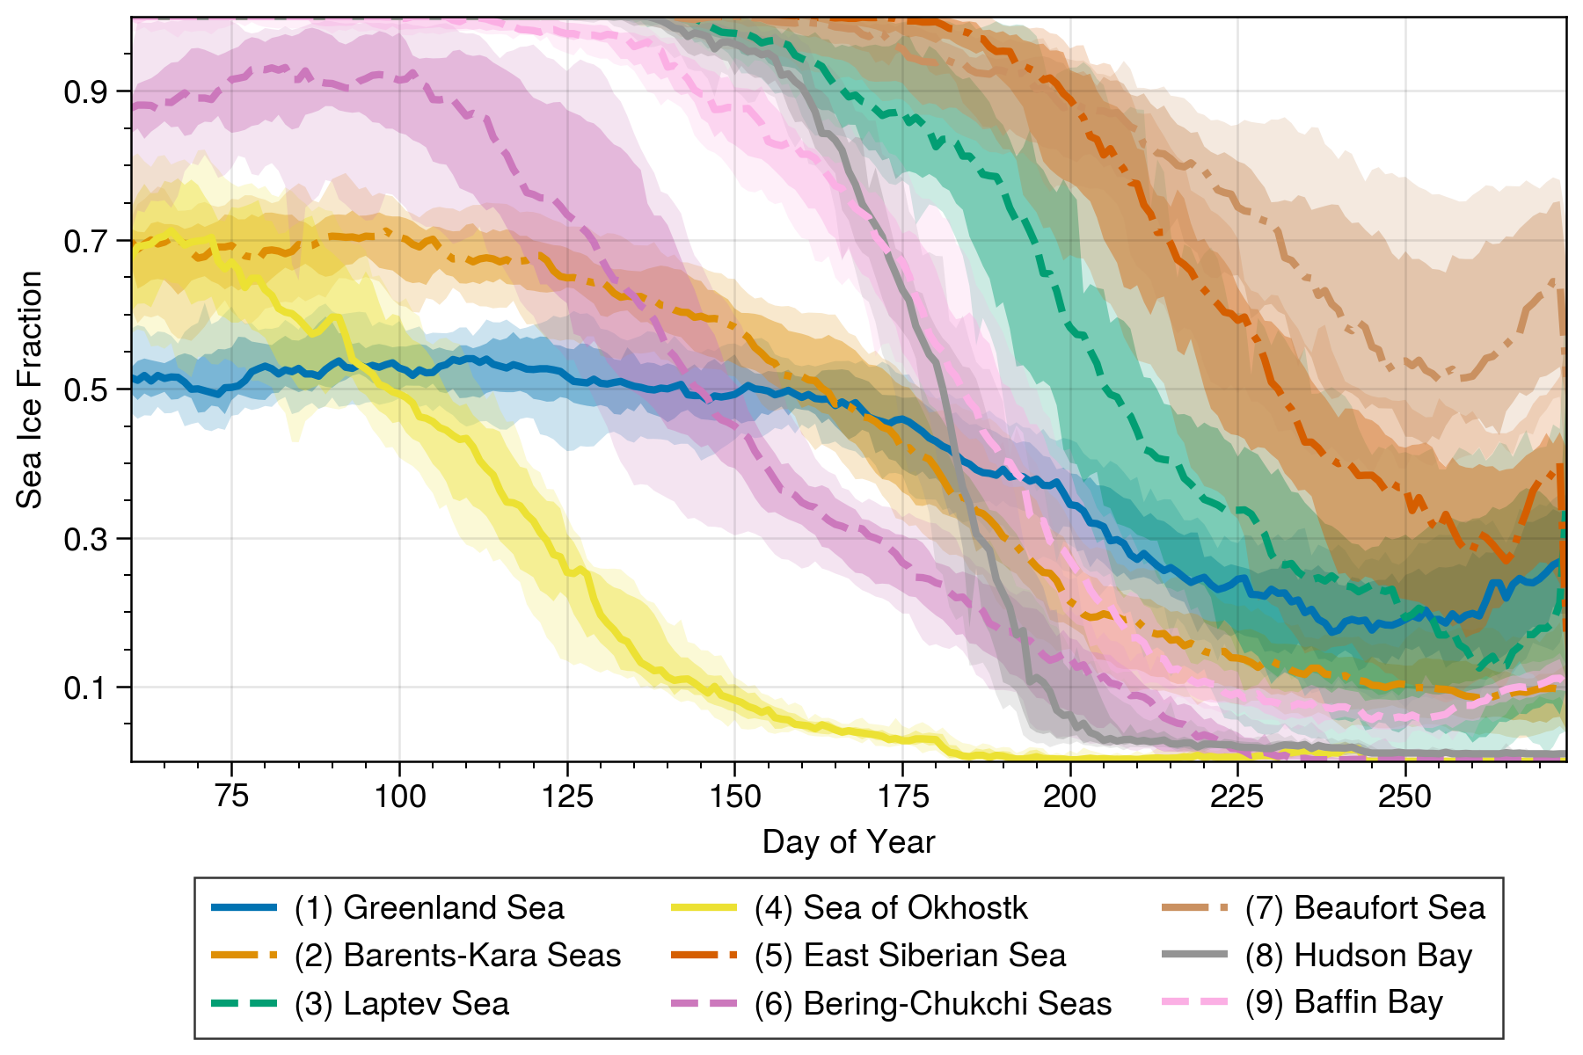

Slide 20
Numerical Experiments
Aim: test the effectiveness of metrics at detecting specific types of error
Representation errors from biased sampling
Remove X% of objects
Remove X% of the large objects (75th quantile and above)
Remove X% of the small objects (25th quantile and below)
Location errors
Simple test with translation by n pixels
Errors in shapes will also affect location. Centroid may move with erosion/dilation, and from merging with nearby objects.

